Slide 1
Project 3: Spanish Wine Analysis
Presented by:
Chelsea J
Morgan M
Sari R
Lana R

Slide 2
With wine and hope, anything is possible.
Spanish Proverb

Slide 3
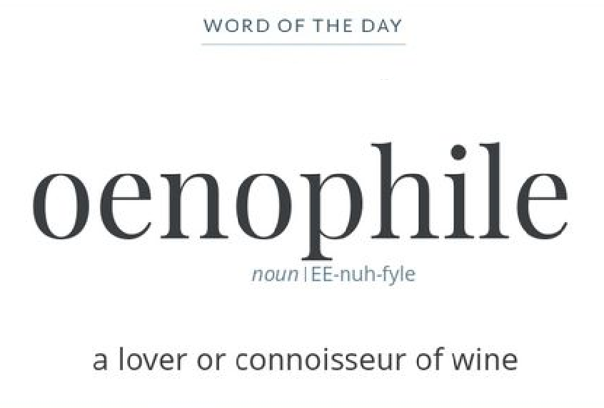
Introduction
Imagine you are planning a vacation to Spain and want to know what region you should visit.
Allow your decision to be guided by Spain’s wine offerings.
We have analyzed a dataset to do just that and invite you to explore our findings!

Slide 4
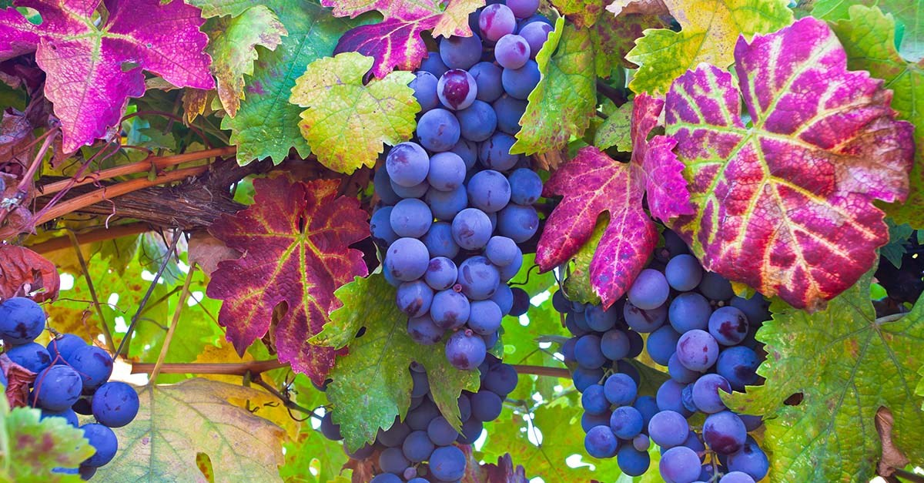
Data Processing
Cleaning & narrowing results
SQLite database & Flask
Javascript
HTML/CSS
Libraries
D3
Plotly
Leaflet
Bootstrap

Slide 5
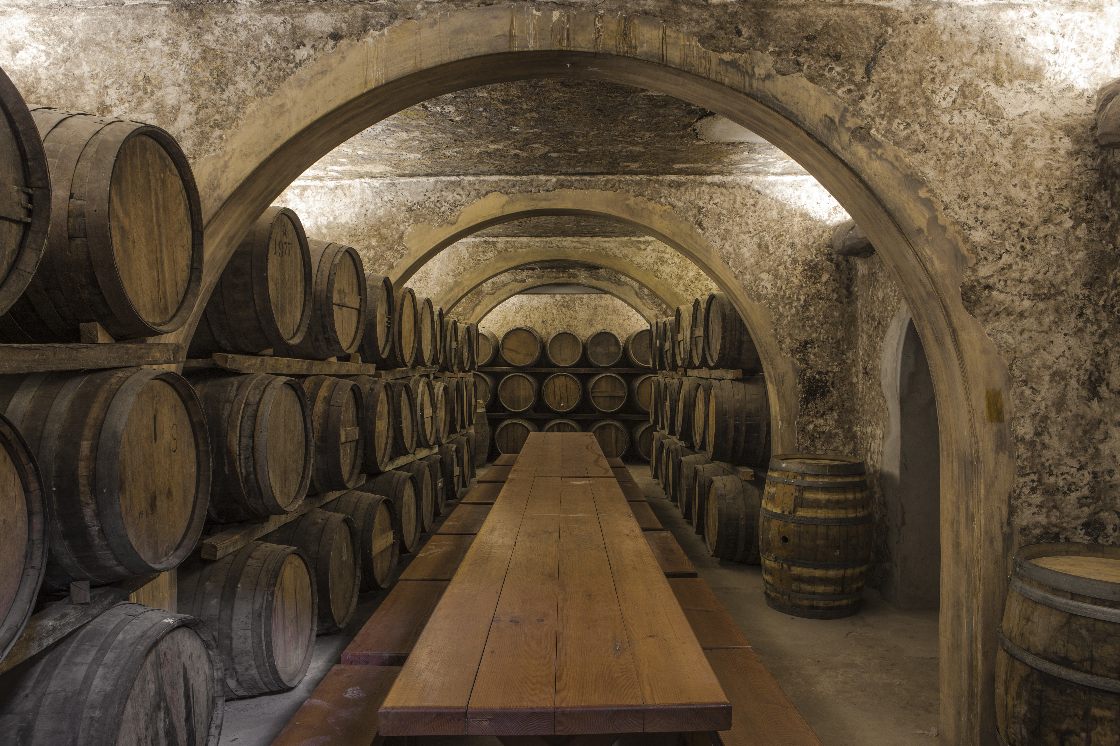

Regions and Wineries
As of 2019, Spain has 138 identifiable wine regions
Most widely planted wine-producing country (2.9 million acres), second largest producer of wine
Over 400 wine varieties
Mountain ranges influence the climate of several wine regions

Slide 6
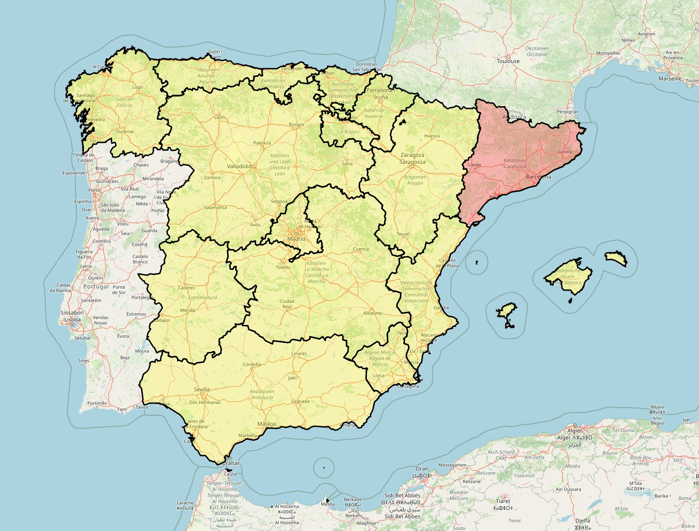
Regions and Wineries

Slide 7

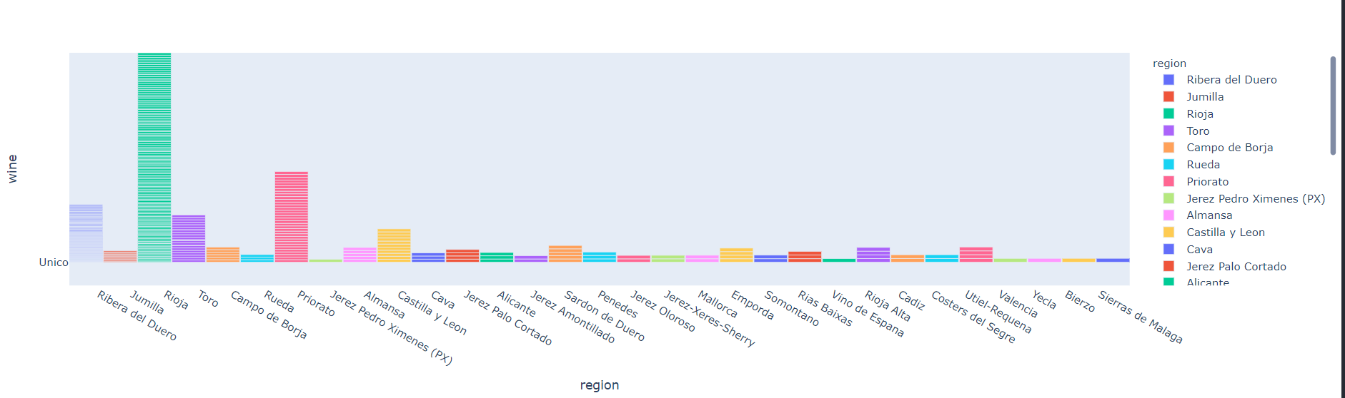
Region and Wine Counts
Comparing total wines produced by region
Interactive hover chart shows wine types

Slide 8

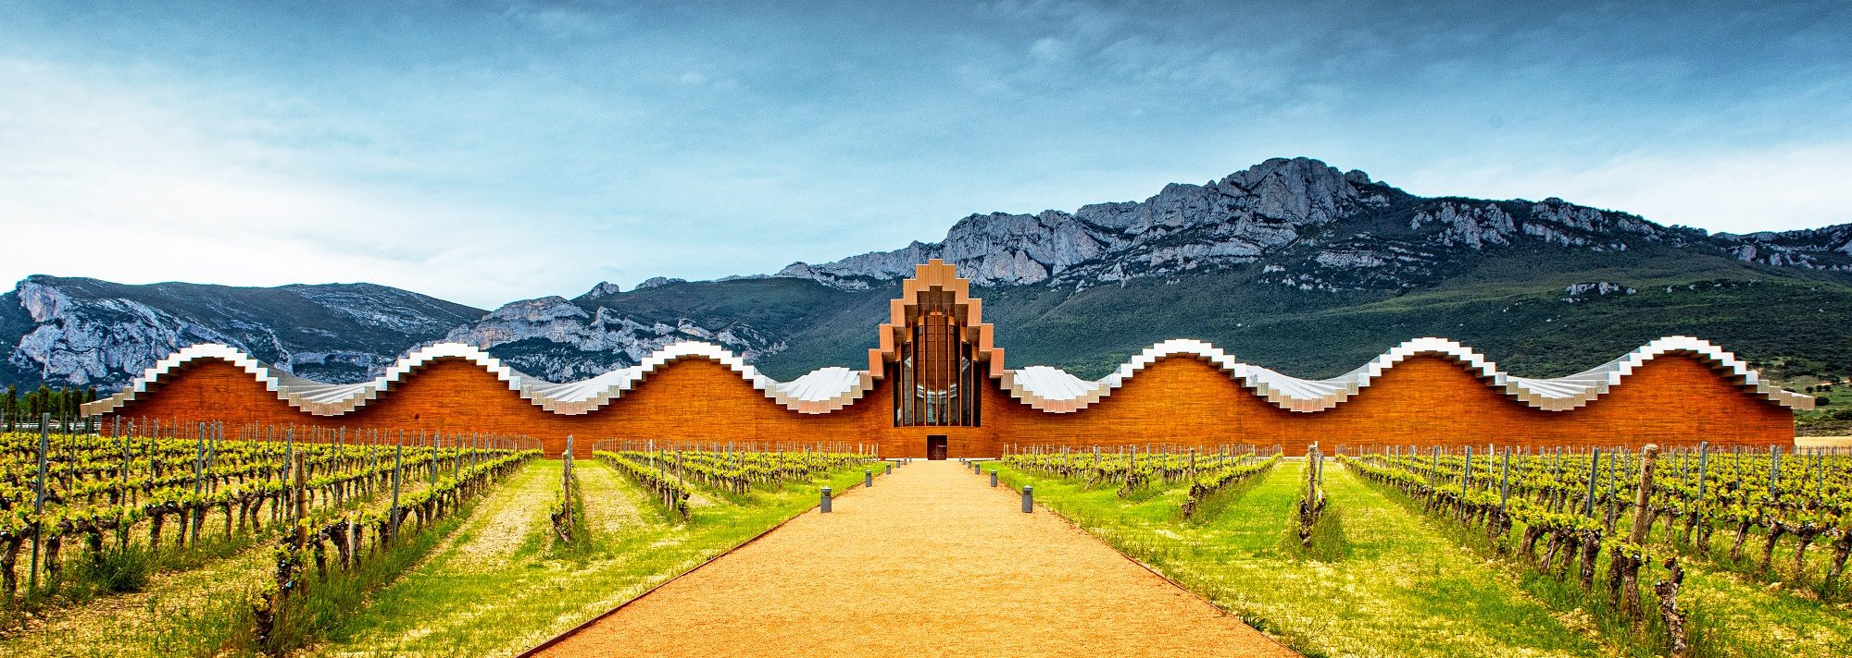
Price & Region
Wine prices range from a few euros to a few thousand euros
Price is not the sole indicator of quality or popularity

Slide 9
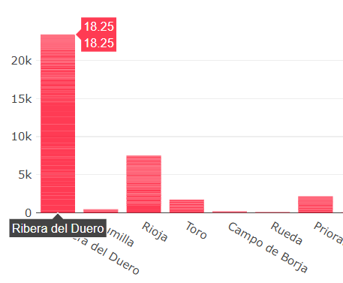
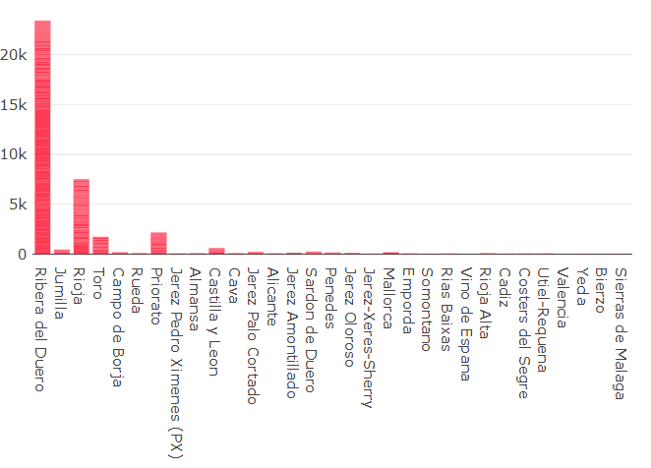
Price & Region

Slide 10
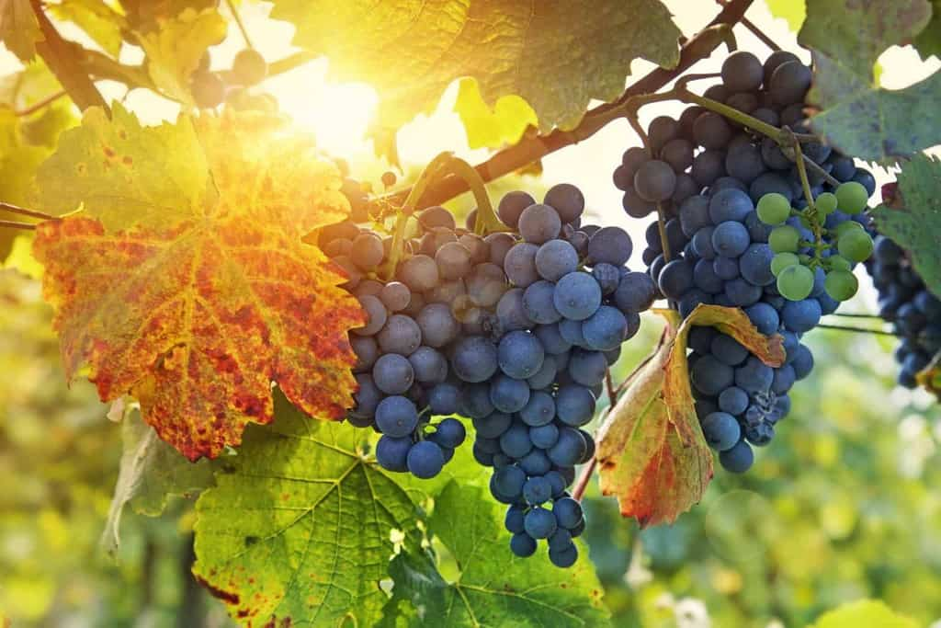
Ratings and Prices
Notes:
(These don’t have designer IDs since they were based off the default master slides already in the deck.

Slide 11
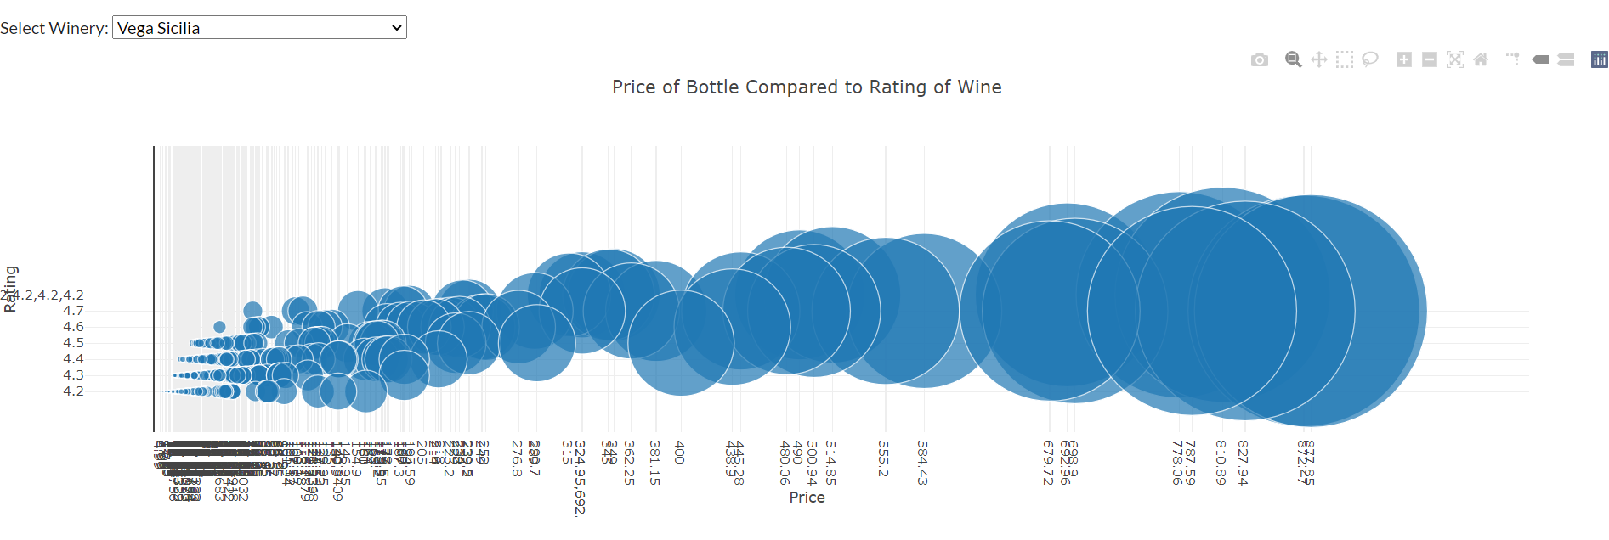
Ratings and Prices
Notes:
(These don’t have designer IDs since they were based off the default master slides already in the deck.

Slide 12
HTML Page Demo

Slide 13
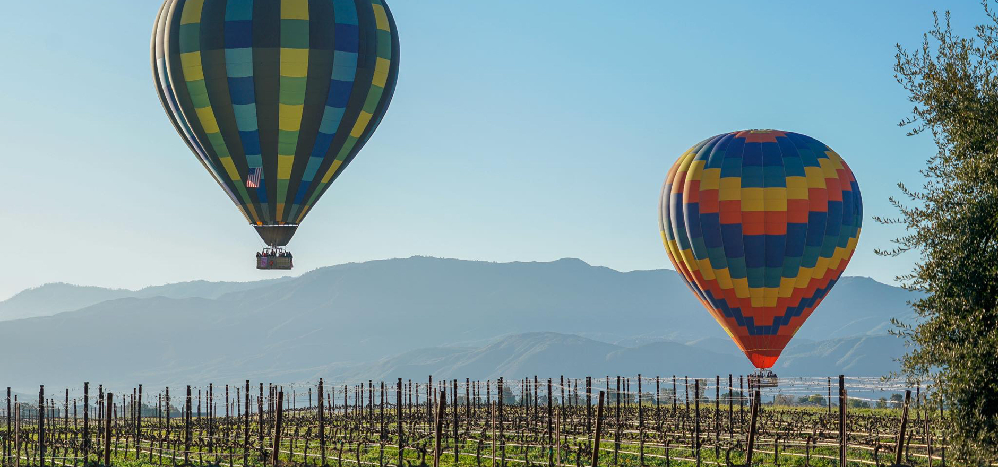
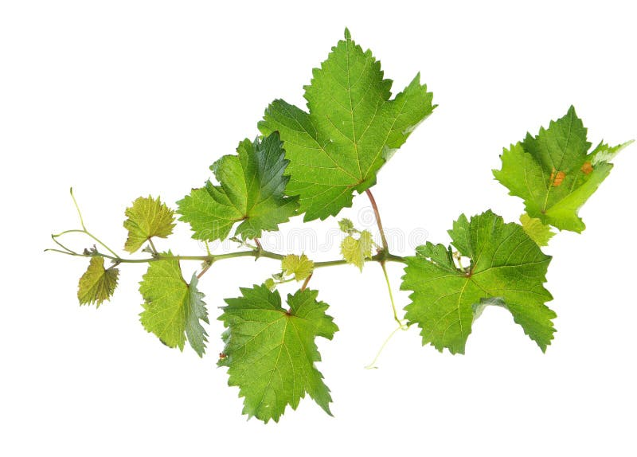
Summary Findings & Opportunities
Constraints
Additional Prospects
Future Development
Disproportionate rating sample size skewed results
May lead to false indicator of popularity, quality, and regional offerings
Customized wine recommendations based on user flavor preference
Potential correlations between harvest year and ratings
Possible links between rating and price
Expansion to include datasets from other countries
Connect with travel sites for enhanced vacation planning

Slide 14
References
https://www.kaggle.com/datasets/fedesoriano/spanish-wine-quality-dataset
https://en.wikipedia.org/wiki/Spanish_wine
https://en.wikipedia.org/wiki/Spanish_wine_regions https://github.com/codeforgermany/click_that_hood/blob/main/public/data/spain-communities.geojson
https://startbootstrap.com/theme/one-page-wonder
https://community.plotly.com/t/bar-width-using-plotly-express/47580/2
https://www.geeksforgeeks.org/create-a-bar-chart-from-a-dataframe-with-plotly-and-flask/
https://www.w3schools.com/js/js_graphics_chartjs.asp
Notes:
(These don’t have designer IDs since they were based off the default master slides already in the deck.

Slide 15

Thank you! Salud!

